Slide 1

Building an Analysis-Ready Data Resource Using a Multi-Stage Pipeline Grace Donovan MSDE/MSDS Practicum 2 Regis University August 21, 2025

Slide 2

Overview
Introduction
Background, Objectives, and Importance
Project overview
Retrieve, Cleanup, and Enhance
Conclusion
Limitations and Future Improvements

Slide 3

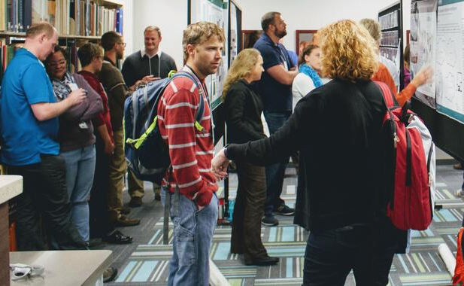
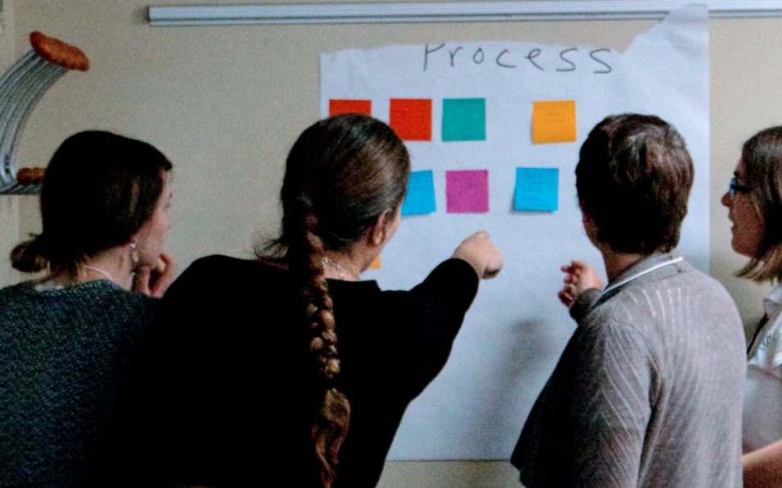
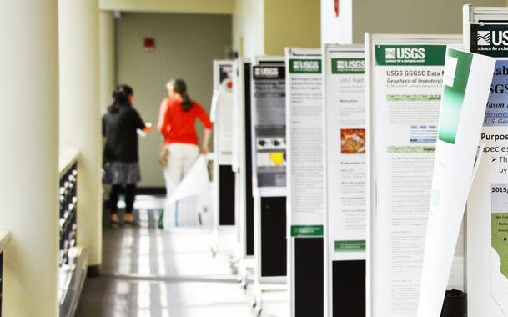
What: Collaborative network of researchers
Why:
Forum for data practitioners to come together, share their knowledge, and learn from one another
Advance understanding of earth systems through use of data, information, tools, and techniques
How:
Collaboration Areas: Groups formed around common interests that help address challenges and identify solutions that enable data integration efforts.
Annual CDI Request for Proposals: Seed funds awarded each year for projects that focus on data integration.
Biannual Workshops: In-person workshop where participants present their work, propose collaborative paths to solve data challenges, and share knowledge with network of peers.
Annual CDI Request for Proposals: Seed funds awarded each year for projects that focus on data integration.
Images sourced from the CDI Website: https://www.usgs.gov/centers/community-for-data-integration-cdi

Slide 4
An Emoji Evolution of Project Objectives
🎯❌ 🔄 🧩📊➡️🗄️ 📈🔍 ✅ 🔙🎯
🎯
🎯🔙
🧩📊➡️🗄️
🧩📊➡️🗄️
❌
Updated Objective
Harmonize, integrate, and enrich CDI project data into a centralized data hub, transforming it into accessible, analysis ready data!
🔄
📈🔍
Initial Objective
Understand how CDI projects have promoted innovation, strengthened collaborative networks, and amplified impact within the scientific community.
✅
Updated Objective
Harmonize, integrate, and enrich CDI project data into a centralized data hub, transforming it into accessible, analysis ready data!
Initial Objective
Understand how CDI projects have promoted innovation, strengthened collaborative networks, and amplified impact within the scientific community.
➡️

Slide 5
Why is Data Integration Important?
“Increasingly, data scientists must first sort through heterogeneous, incongruent, and fragmented datasets before any analyses can be conducted. Such problems with data availability are often exacerbated in emergency situations where real time analyses are often stymied by unevenly documented or unclean data.”
(Cheng, C. et al, 2024)
“Integrating structured, semi-
structured, and unstructured data is crucial for insights and decisions. However, complexities like format
mismatches, data quality issues, and interoperability hinder efficient data utilization”
(Mirza, F., 2021)
“One of the great challenges of data-driven research is that data rarely come in a form that is immediately ready for analysis.”
(Huber, R. et al, 2021).
“Data integration solutions leveraging data-driven techniques improve data-delivery capabilities and facilitate data analytics.”
(Liu, D. and Yoon, V., 2024)
“Integration of existing information systems is becoming more and more indispensable in order to dynamically meet business and customer needs while leveraging long-term investments in existing IT infrastructure.”
(Ziegler, P., and Dittrich, K., 2007)

Slide 6
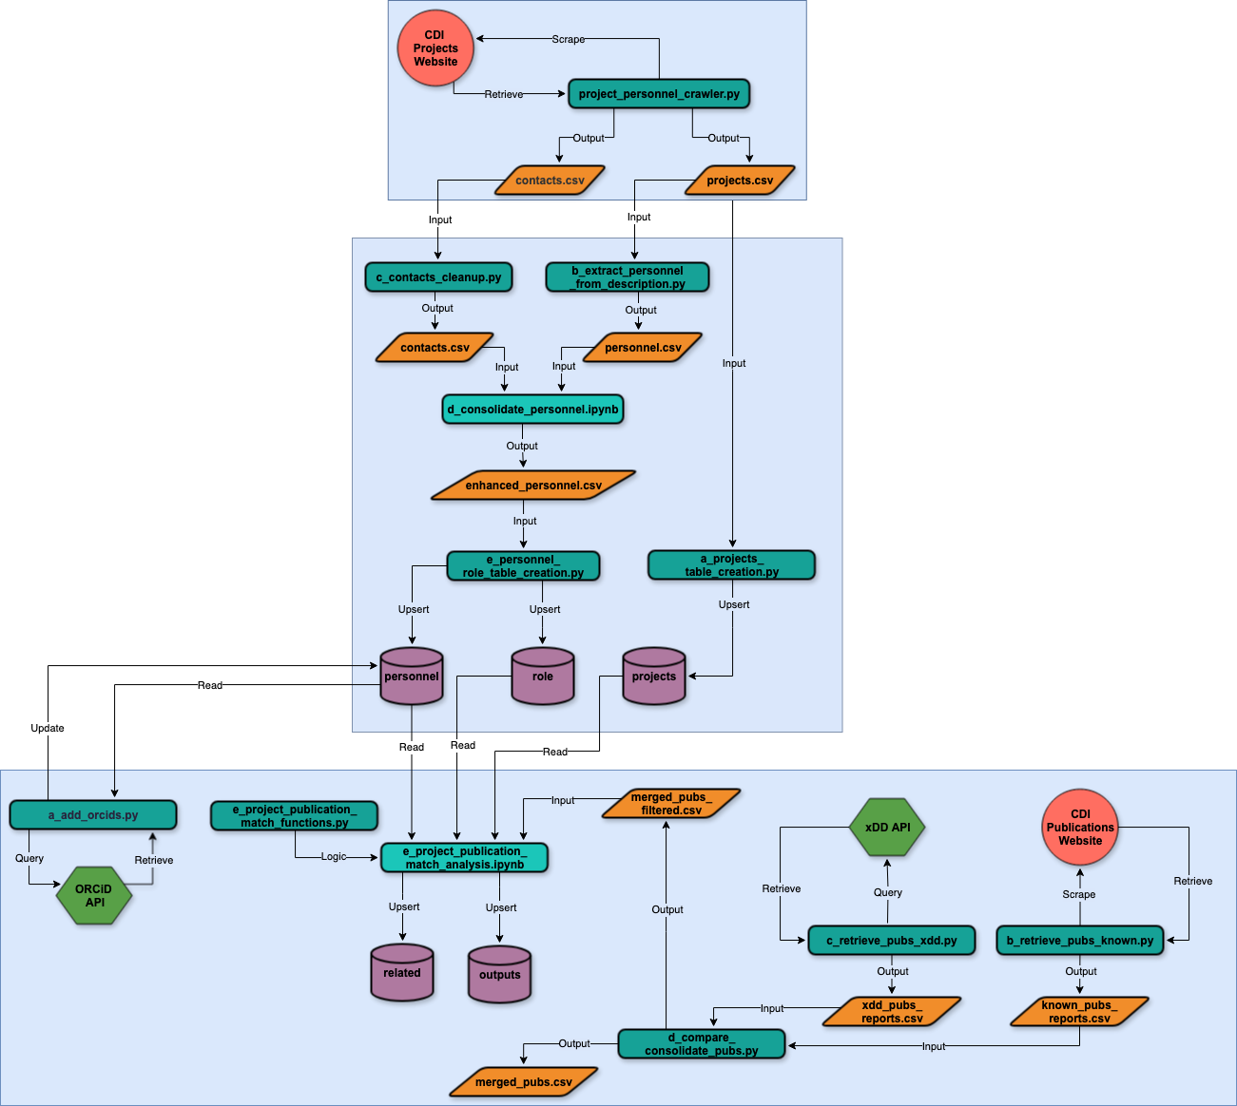
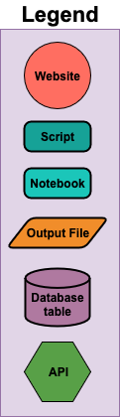
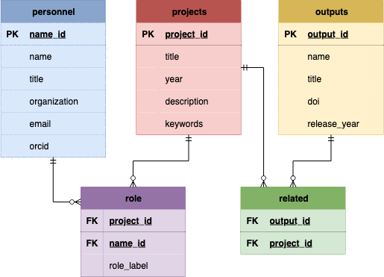
Overview
Retrieve
Cleanup
Enhance

Slide 7
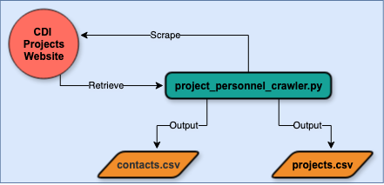

Retrieve
Scrape full-text content from CDI project web pages
Extract title, year, description, and contacts
Export structured project and project contacts (personnel) data

Slide 8
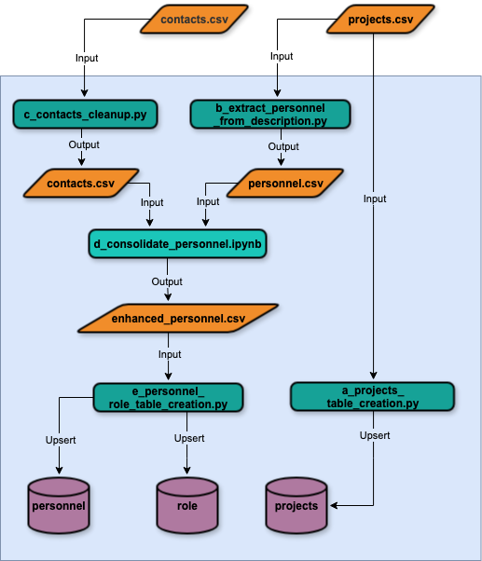
Cleanup
Projects: clean descriptions, assign unique identifiers, extract top-5 keywords, upsert into projects table
Personnel: regex-parse and clean names, tag lead PI versus collaborators, and standardize entries
Consolidation: merge personnel information from contact sections and descriptions, fuzzy-match name entries, select representative personnel entries, and remove duplicates
Final Load: assign each personnel entry a unique identifier, upsert into personnel and role tables in database

Slide 9
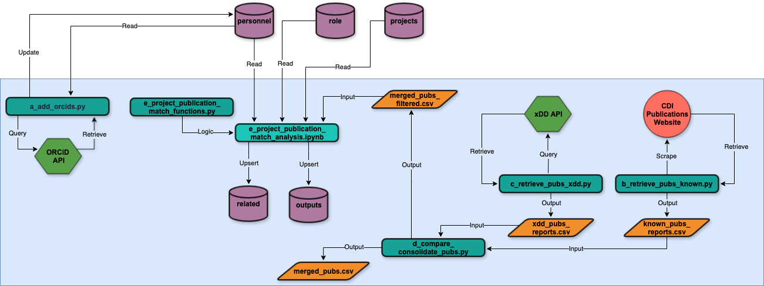
Enhance
ORCID enrichment via ORCID API
Known publications retrieval from CDI
xDD API publication extraction
Publications consolidation and filtering
Project-publication matching and upsert

Slide 10

Limitations
Missing and incomplete publicly accessible CDI project data
Project personnel may not have ORCIDs or have different names associated with their ORCIDs
xDD is not a comprehensive corpus of all published works by CDI project personnel
Project personnel may not be acknowledging the CDI or have cited the CDI inconsistent ways in their outputs
Heuristic matching errors
Fixed database schema may require refactoring if new data types are included in the future

Slide 11


Data Integration
🗄️ = 📈🔍

Slide 12
References
Cheng, C., Messerschmidt, L., Bravo, I. et al. A General Primer for Data Harmonization. Sci Data 11, 152 (2024). https://doi.org/10.1038/s41597-024-02956-3.
Community for Data Integration (CDI). (2025). What We Do, https://www.usgs.gov/centers/community-for-data-integration-cdi/what-we-do.
Community for Data Integration (CDI). (2025). Participate, https://www.usgs.gov/centers/community-for-data-integration-cdi/participate.
Huber, R., D’Onofio, C, Devaraju, A., et al. (2021 Integrating data and analysis technologies within leading environmental research infrastructures: Challenges and approaches, Ecological Informatics, https://doi.org/10.1016/j.ecoinf.2021.101245.
Liu, D., and Yoon, V. (2024). Developing a goal-driven data integration framework for effective data analytics, Decision Support Systems, https://doi.org/10.1016/j.dss.2024.114197.
Mirza, F. (2021). Integrating with Various Data Sources and Formats, Including Structured, Semi-Structured, and Unstructured Data, Journal of Scientific and Engineering Research, 8(2):263-268, https://jsaer.com/download/vol-8-iss-2-2021/JSAER2021-8-2-263-268.pdf.
Wilkinson, M., Dumontier, M., Aalbersberg, I. et al. The FAIR Guiding Principles for scientific data management and stewardship. Sci Data 3, 160018 (2016). https://doi.org/10.1038/sdata.2016.18/
Ziegler, P., Dittrich, K.R. (2007). Data Integration — Problems, Approaches, and Perspectives. In: Krogstie, J., Opdahl, A.L., Brinkkemper, S. (eds) Conceptual Modelling in Information Systems Engineering. Springer, Berlin, Heidelberg. https://doi.org/10.1007/978-3-540-72677-7_3,

Slide 13

Thanks!

